Slide 1
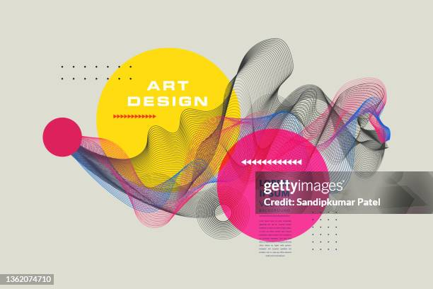
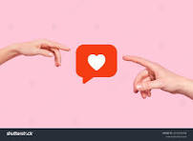
Alfred Barr: Cubism and Abstract Art and how does media influence art?
By: Terry Jung

Slide 2
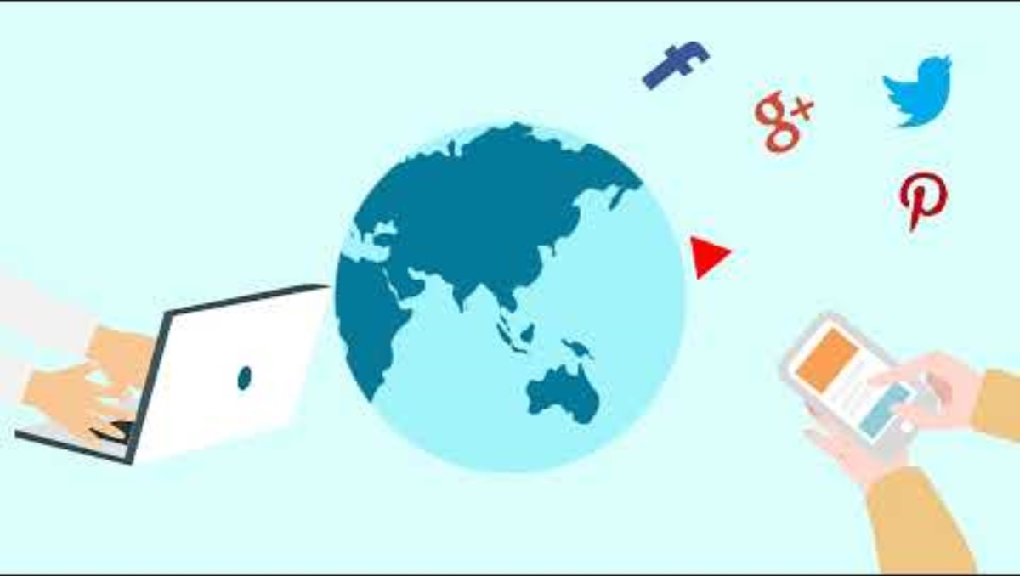
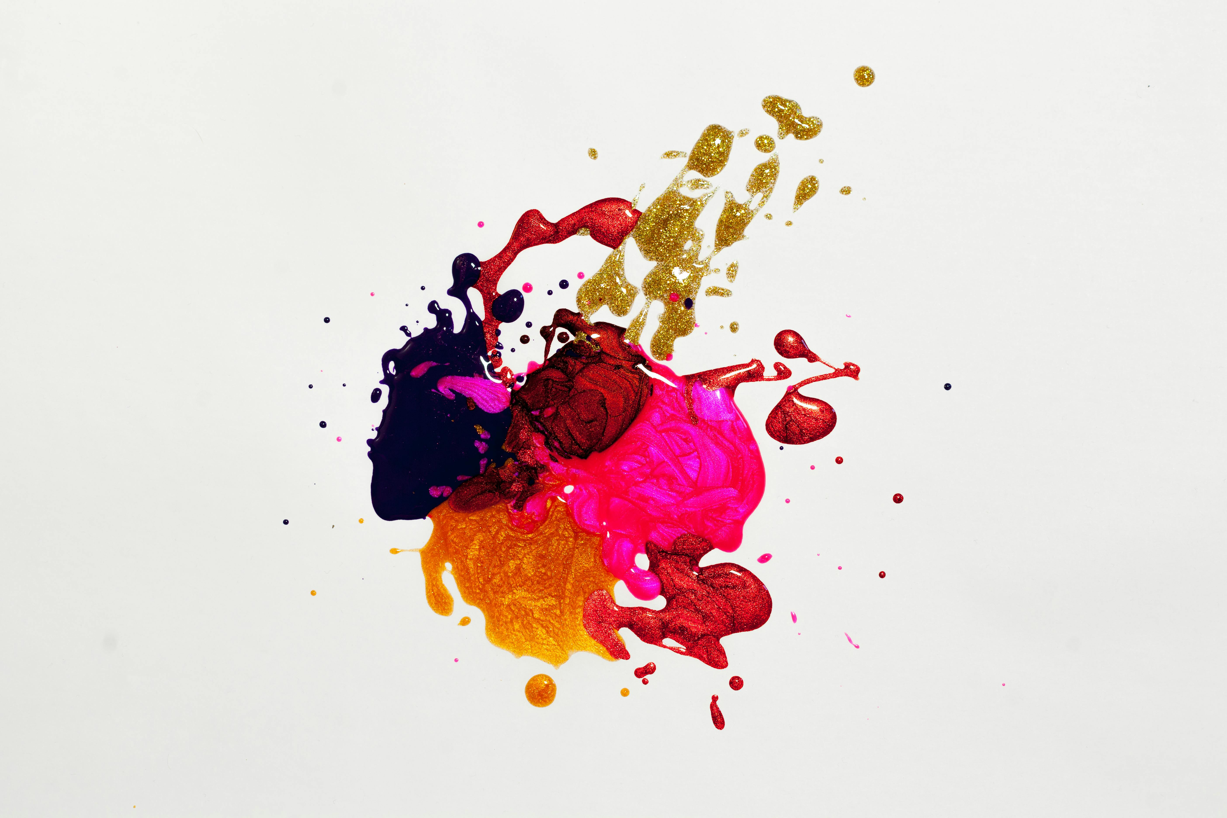
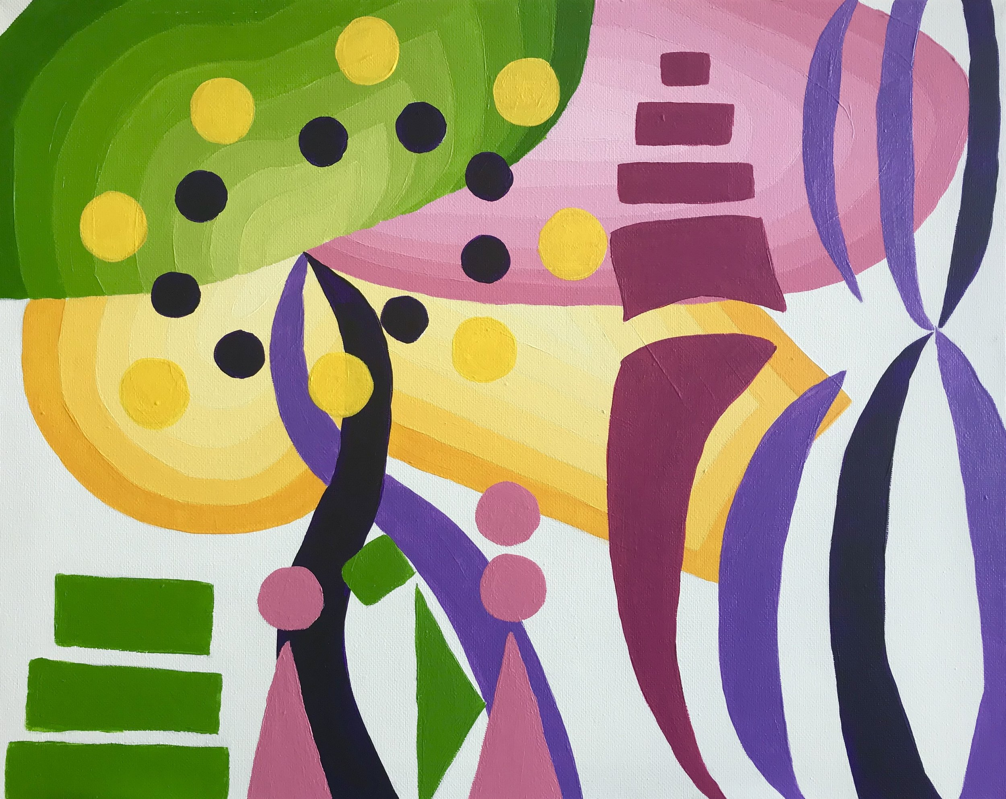
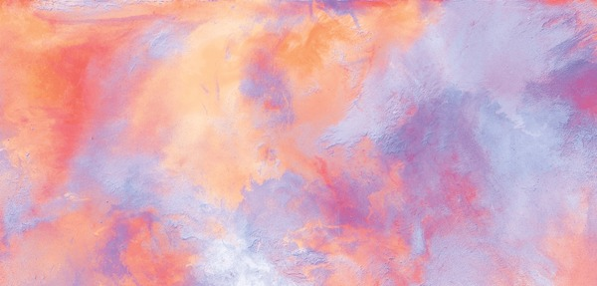
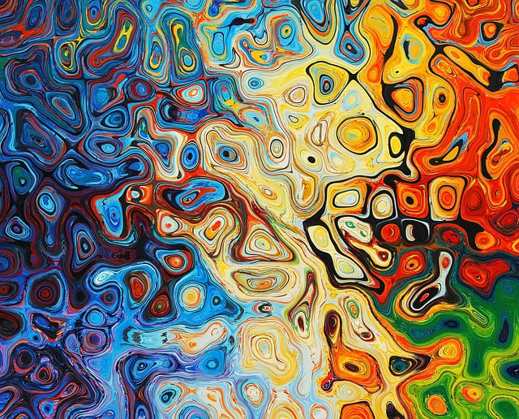
Media is many forms of connections which includes online news articles, and a news broadcast. Social Media can be a form of media because the platform uses a certain algorithm which engages the audience's attention. Video Games are a form of media because individuals can play the game with some concepts of the games that come to mind when they are playing. Media is an art form because the artworks depicts certain images of the articles, TV shows, and films. According to Social Media: Definition, Importance, Top Websites and Apps, the narrator stated that Social media marketing is the use of social networks as a sales and marketing tool. Companies with products or services to promote can go beyond traditional advertising to build an online presence and engage directly with their customers.

Slide 3
List of ideas of social media and art
. What is social media in art?
. Why is abstract art relevant in media
. How are social media and art similar?
. How are media and art related?
.How can social media and art be related?
.What can we see on media that changes our viewpoints of the world around us?
.How does media correlate with art?
..Relation of Social media and Art.
. How does hypermedia relate to social media and art?

Slide 4
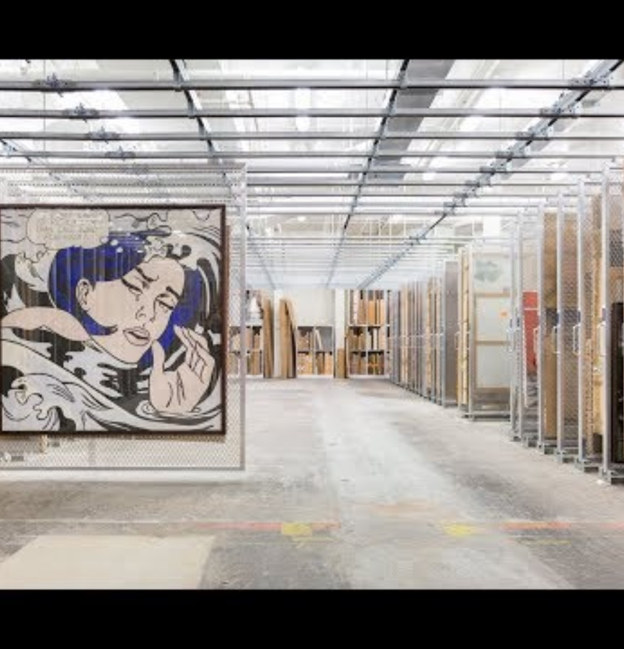
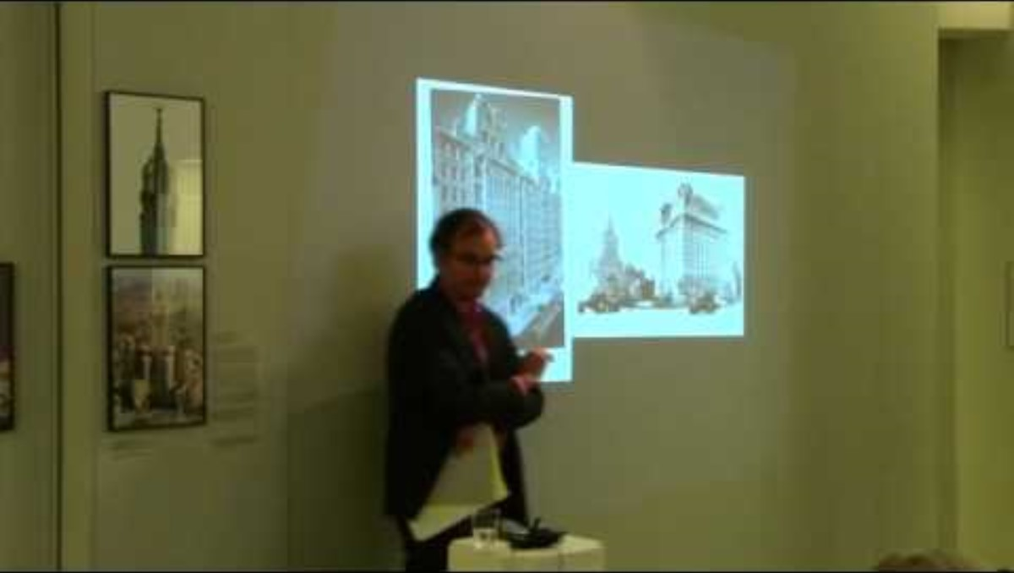
Media and Art, and connections to multimedia
In multimedia, the book says, that artistic man can only fully content himself uniting every branch of art into the common Artwork: In multimedia, the book states that in every segregation of his artistic faculties, according to multimedia, the book stated that he is un-free, not fully that which he has power to be.
According to multimedia, the book states that whereas the public, that representation of daily life, forgets the confines of the auditorium, in multimedia, the book mentions, and lives, and breathes now only in the artwork which seems to it as Life itself, according to multimedia, the book mentioned, and on the stage which seems the wide expanse of the whole World.
In the multimedia, the book says that architecture can see before herself no higher task than to frame for a fellowship of artists, according to multimedia, the book stated that, who in their own persons portray the life of Man, the special surroundings necessary for the display of the Human Artwork.

Slide 5
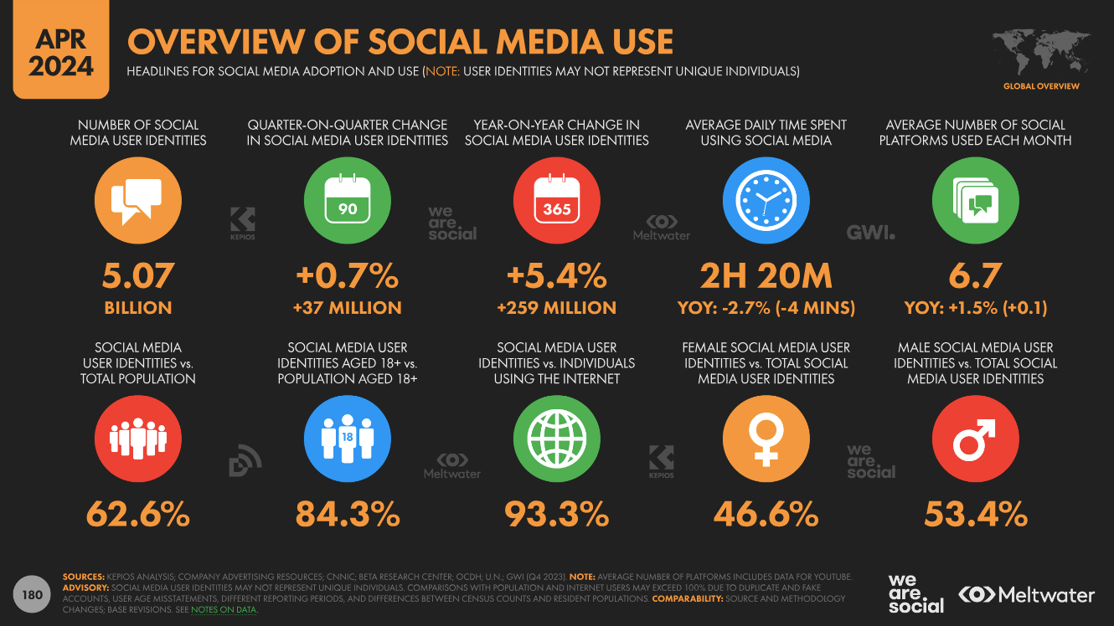
Stats of Social Media and how it is related to art?
The Stats tell the audience how social media can affect different users. The audience view certain social media platforms on average with something that relates to art. According to Global social media statistics research summary May 2024, the article states that Datareportal regularly updates its global compendium of social media statistics, which we recommend as it gives some great insights into the world of social media. It's a great download for including slides for your presentations. Note that their data is compiled from other sources of which the Global Web Index panel is the best source, although only available to paid subscribers. If you're researching social network adoption, it's worth checking out GWI's top 10 2024 social media statistics and their free annual report of social media trends.
Creator: MeltWater

Slide 6
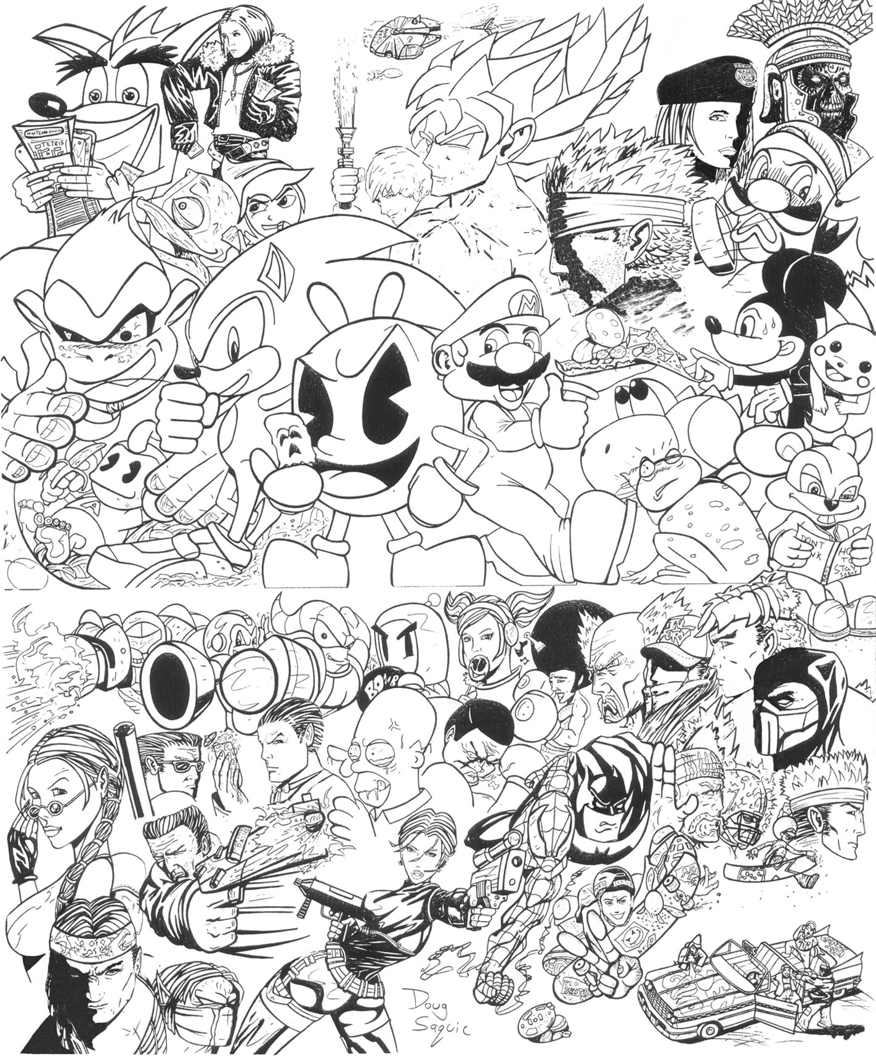
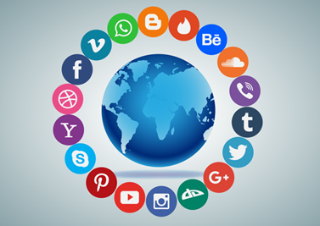
Academic Summary of Chapter 1, Outline of Artwork of the Future, The Artwork of the Future (1849)
Electronic Media can be anything from social media, video games, and art which includes a certain story to the game, and the movies, or when the artists draw certain images that relates to their own experiences. According to the Outline of Artwork of the Future, the Artwork of the Future, the books says the orchestra is, so to speak, the loam of endless, universal Feeling, in the Outline of Artwork of the Future, the Artwork Future, the book mentions, from which the individual feeling of the separate actor draws power to shoot aloft to fullest height of growth: according Outline of Artwork of the Future, the Artwork of the Future, the books stated that, to the it, in a sense, in the Outline of Artwork of the Future, the Artwork of the Future, the book mentions that dissolves the hard immobile ground of the actual scene into a fluent, elastic, impressionable aether, according to the Outline of Artwork of the Future, the Artwork Future, the book mentioned, whose unmeasured bottom is the great sea of Feeling itself on the walls were painted animal images and shamanist scrawls, according to the Outline of Artwork of the Future, the Artwork Future, the book stated that, but the environment in which the paintings appeared was surely as significant as the paintings themselves.
Creator: DougSQ, and Stux, Pixabay

Slide 7
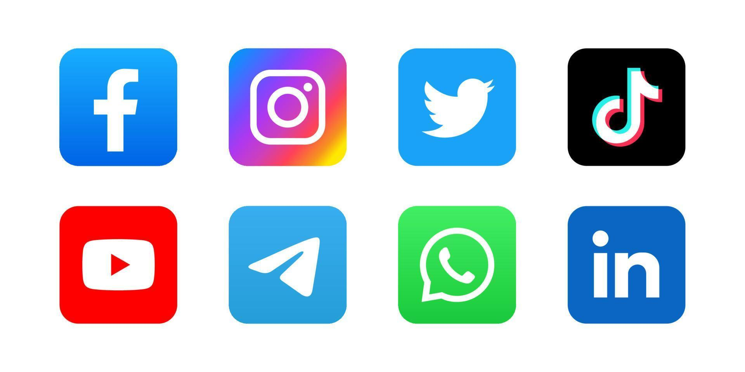
The affects of Social Media on art?
Social Media can affect the users view of certain artworks from the public’s view of the artists artworks from their own experiences. In How Social Media is Impacting Artists, the article mentioned that to partly overcome this, on 19 February 2023, Meta announced they were testing a new offering called ‘Meta Verified’. The so-called goal of this new subscription-based model is to offer “proactive account protection, access to account support, and increased visibility and reach” (Meta Newsroom, 19 Feb 2023). Yet this proposed introduction potentially has more detrimental effects than positive ones: firstly the verification will be subscription based requiring a minimum of USD11.99 per month on the web or USD14.99 on iOS or android – a minimum of USD143 a year. This will severely limit the reach of those at the start of their careers, with little disposable income and many minorities.
While technology has helped the arts evolve, for some artists technology or at least some forms of technology is at a tipping point where it is hurting their mental health, their creativity and potentially their livelihoods.
Since the emergence of modern social media platforms such as Facebook, Instagram, Pinterest, Tumblr, and TikTok we have seen a difference in how the art world has been able to connect with other artists, galleries, curators, magazines, admirers and collectors. Despite bringing about many positive changes the negative impacts can not be overlooked.
Likewise, there is much debate about the ethics and role of AI art-generating tools and their impact on artists.
In this two-part series, we discuss how social media and AI art-generators are negatively impacting the art world. Part II: AI Art & the Ethical Concerns of Artists will be published next week.
Creator: Nur Muaulidiah

Slide 8
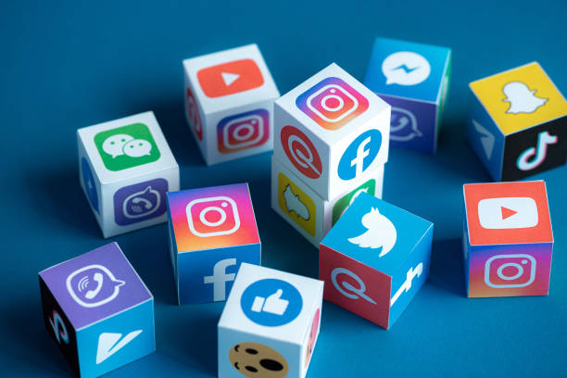
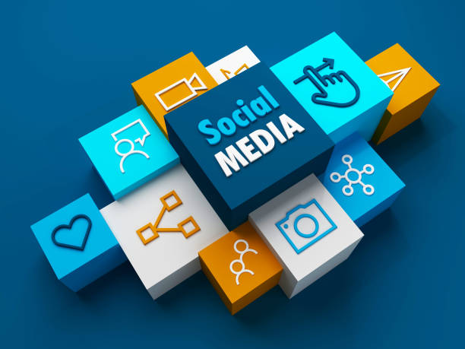
Relation of Social Media and Art
Social media and art is related because artists can post their artworks to social media, and to different platforms which includes YouTube, Instagram, and other social media apps. According to art in the age of social media, the article states that, for artist-users of social media platforms, these sites function as valuable tools for discovering other artists, finding inspiration, learning new techniques, researching culture, connecting to others, forming communities, starting collaborations and growing networks. For the platform creators, the sites are a lucrative system that harvests vast amounts of data on individuals, profiles and categorizes them, and sells their attention to advertisers. In art and social media: the impact of digital platforms on art consumption, the article mentioned that digital technology has also transformed the way art is created, with artists embracing new tools and techniques to push the boundaries of creativity. From digital painting software to virtual reality installations, technology offers artists endless possibilities for experimentation and innovation. Digitalization in art has opened up new avenues for artistic expression, blurring the lines between traditional and digital mediums. According to a deep look at digital media and art and social media, the article mentions that, in the same way that technological advances have opened-up the possibilities for people to create digital art – social media and other online platforms have made enjoying, sharing and buying art, more accessible. Social media affects the audience because certain individuals can have a misconception of certain social media posts. The effects that I think social media has on culture and future media is that social media can use an algorithm, so that the audiences cannot tell the difference between AI or an actual content creator who creates good artworks. The social media can use misinformation to convince the public about certain issues in today’s world. In the global views of social media and its impact on society, the article says that, when asked whether social media is a good or bad thing for democracy in their country, a median of 57% across 19 countries say that it is a good thing. In almost every country, close to half or more say this, with the sentiment most common in Singapore, where roughly three-quarters believe social media is a good thing for democracy in their country. However, in the Netherlands and France, about four-in-ten agree. And in the U.S., only around a third think social media is positive for democracy – the smallest share among all 19 countries surveyed.
Creator of art: HowLettery, and pressureUA

Slide 9
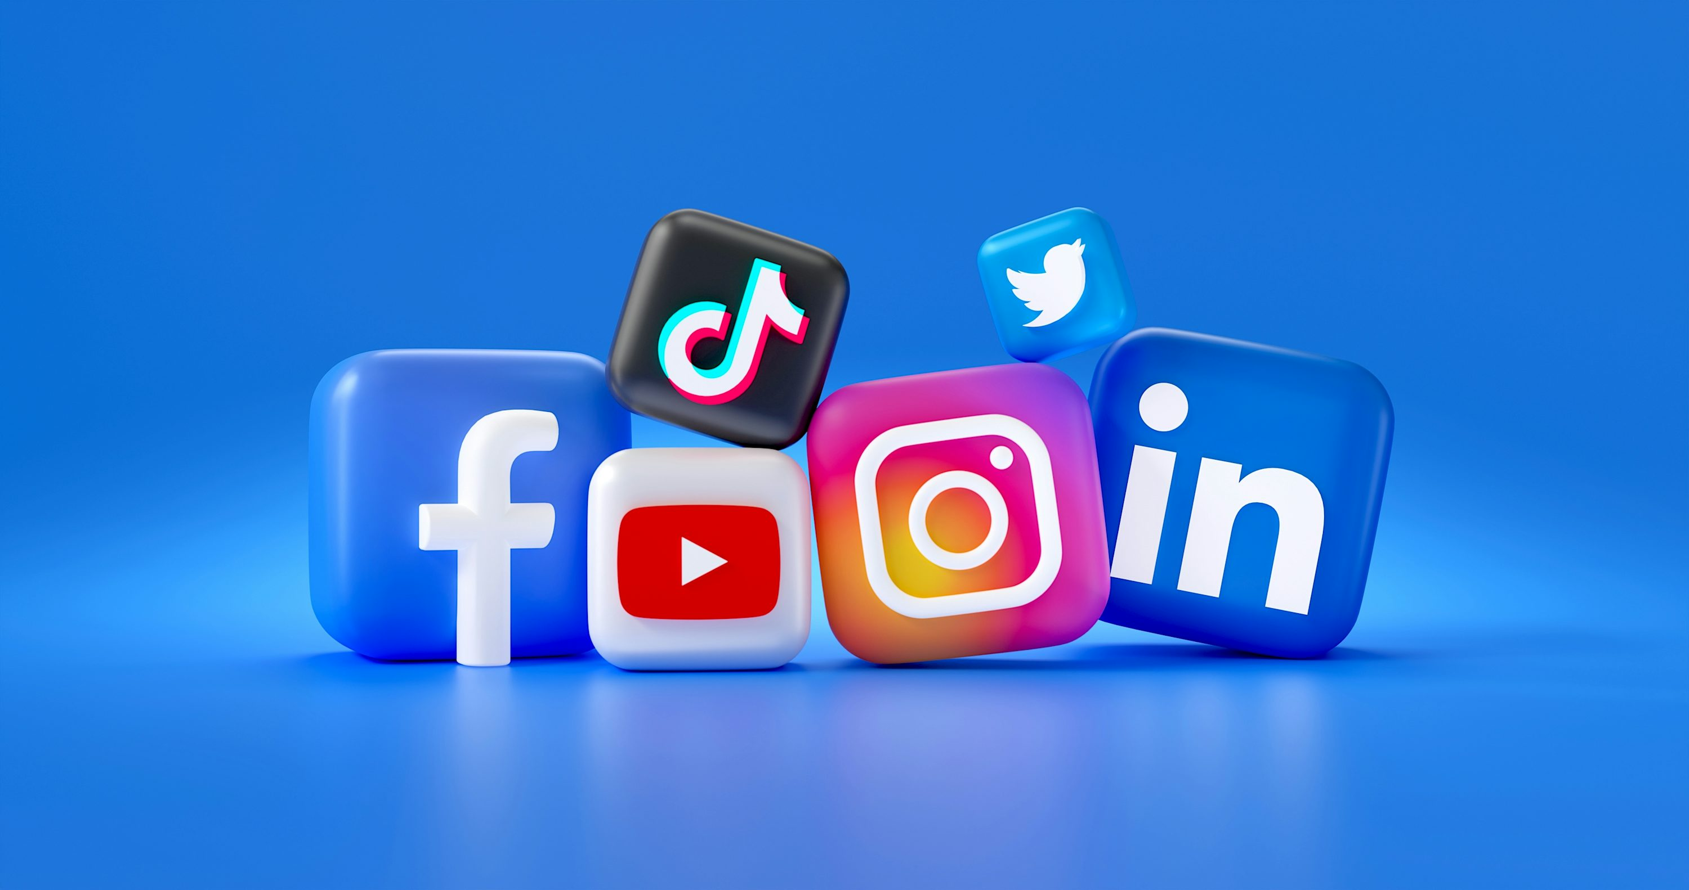
What is social media in art?
Social media can be art because the artists use certain artworks to express some ideas about the world around them. According to the Benefits of Social Media for Artists, the article stated that, when utilizing social media, you can meet and interact with people around the world. For artists, this can be priceless. The more experiences and interactions artists have with the world, the more their art is influenced and potentially strengthened. By seeing other artist's work and interacting with the artists themselves, you can grow and expand your thoughts, building creative ideas unique to you and your experiences.
Creator: Maria Shalabaieva

Slide 10
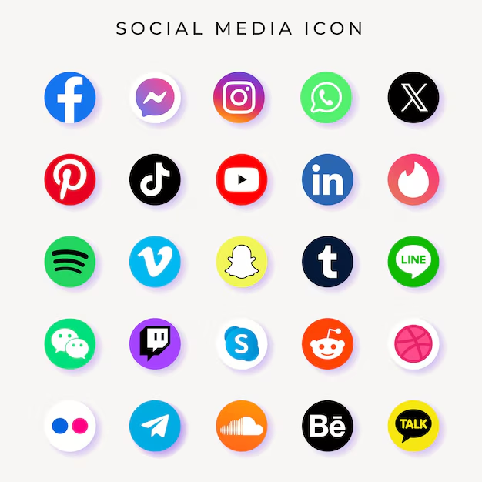
Why is abstract art relevant in social media?
Abstract art is relevant in social media because the artists can express a certain feeling about their own experiences. According to the abstract art and realism are valid and important forms of visual expression, the article mentioned that, in contrast, realism, especially hyperrealism, receives a lot of criticism for its apparent inflexibility. In the abstract art and realism, the article stated, I have heard many people opine that while realistic art requires a lot of technical ability, it also lacks in creativity, depth and taste. According to the abstract art and realism, the article says, while I agree that realism doesn’t leave much room for interpretation or exploration and relies on skill rather than imagination, it is still equally as valid as other art styles.
Creator: owngraphic1

Slide 11
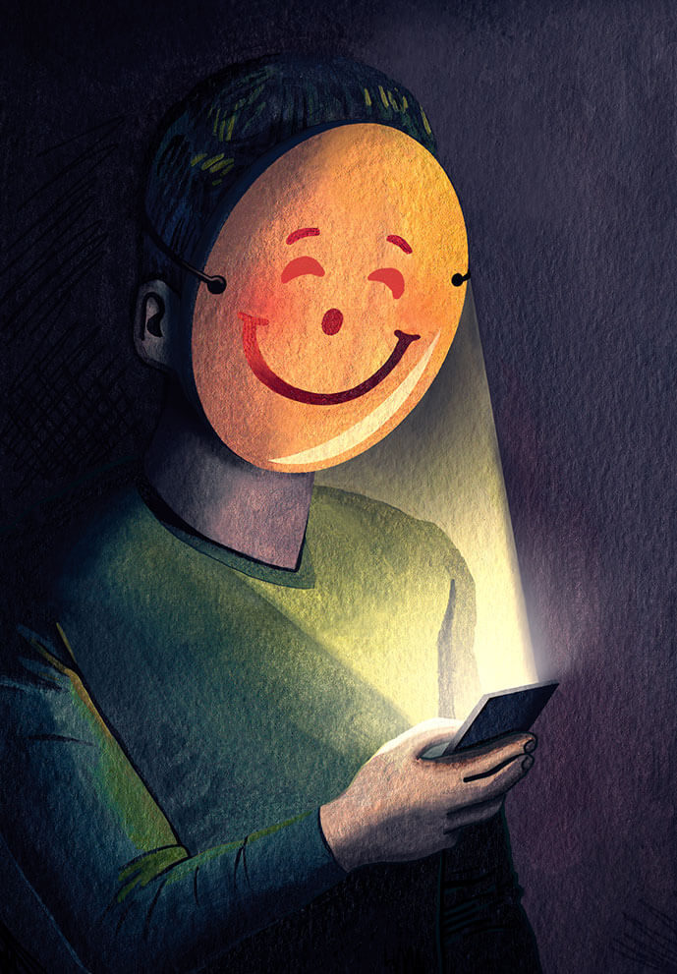
How are social media and art similar?
Social media and art similar because the artists use different aspects of expressionism, and surrealism, when the artists are painting their artworks with their own experiences. The artists posts their art on social media, so that it is appealing to the audience. According to how social media is shaping art, the article stated that, almost every aspect of our lives is now being dictated by social media. In how social media is shaping art the article, says that we look to the omnipresent, all-seeing forces of Instagram, Facebook and Twitter to communicate, keep up with the world, schedule our events, satisfy our most materialistic needs or even quench our thirst for activism, the list goes on. According to how social media is shaping art, the article mentions, social media is therefore only natural for art, in its ceaseless ability to both reflect and influence its host cultures, to be entwined in the ever-growing web of social media. According to how social media is shaping art, the article stated, but the relationship between these two worlds is like any, enriching yet troublesome at times. In how social media is shaping art, the article, while social media has the ability to liberate and foster art to a prodigious extent, it also raises queries of censorship, and blurs the distinction between art and those categories of creation or design that might aspire to that status.
Creator: Haydn Symons

Slide 12
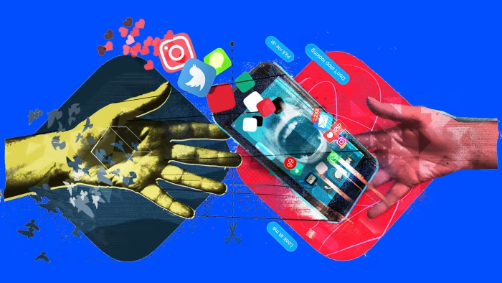
How can social media and art be related?
Social media and art can be related because certain artists can post their own artworks, so that the art can have a certain connotation to it. According to is social media making art bad, the article stated that social media is a double-edged sword for artists. In is social media making art bad, the article says, while it offers incredible opportunities for exposure and inspiration, it also has the potential to negatively impact creative integrity. The key lies in using these platforms mindfully. According to is social media making art bad, the article states, by focusing on authentic creation, setting boundaries, and engaging meaningfully, artists can harness the positive aspects of social media while mitigating its drawbacks. In is social media making art bad, the article stated that, remember, your art is a reflection of your unique perspective, and that is what makes it truly valuable.
Creator: Tim Marrs

Slide 13
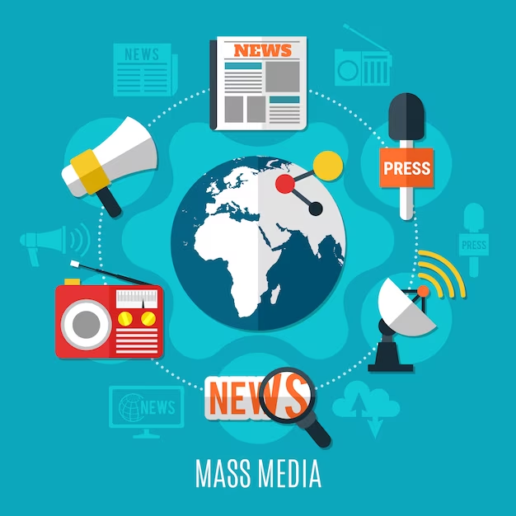
What can we see on media that changes our viewpoints of the world around us?
Individuals can listen to the radio and watch news broadcast, but it can be misleading because certain platforms use misinformation without researching the facts behind the statement. According to a virtual life: how social media changes our perceptions, the article mentioned that, while each social media site has its own personality and purpose, the wildly popular Facebook with its estimated one billion active monthly users has gained the most attention from psychologists for its potential to distort an individual’s sense of self and sense of other people. In a virtual life: how social media changes our perceptions, the article states, the magnetism of social media in conjunction with the effects on reality while diminishing individuality comes with significant consequences.
Creator: Freepik

Slide 14
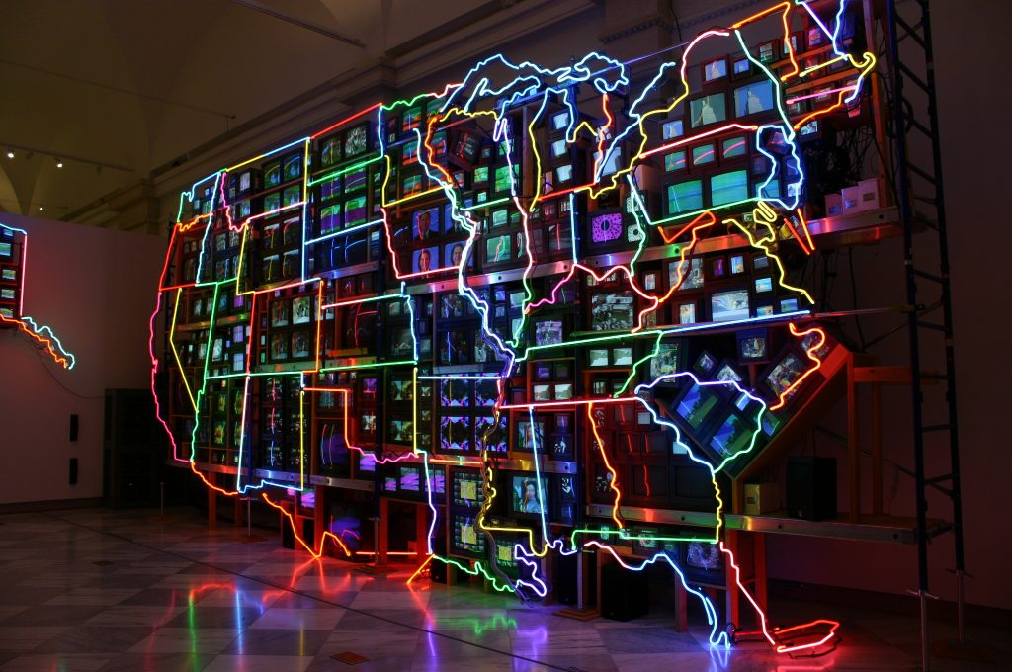
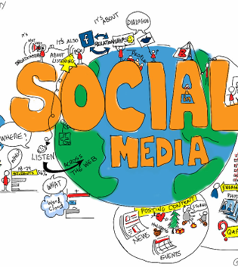
How does social media correlate with art?
Social media correlates with art because the artists use some surrealism to make their artworks with their own experiences and perspectives of the art world, and then the artists would post their artworks on social media platforms. According to the impact of using social media as an artist, the article mentions that, before the Internet, artists would have studio visits from curators, gallerists, collectors, buyers, writers, and other artists who were interested in their work. In the impact of using social media as an artist, the article mentioned that this is how artists were able to get their artwork and their name out into the professional world. In the impact of using social media as an artist, the article says that the artists used to also rely on visiting exhibition openings where lots of creative people gathered. According to the impact of using social media as an artist, the article states, that through these social connections, the artist would receive opportunities. In the impact of using social media as an artist, the article stated that the artists artwork would go on to be shown in galleries. In the impact of using social media as an artist, the article states that through exhibitions and reviews of those shows, the artists artwork would be given cultural and financial value. According to the impact of using social media as an artist, the article says that the artists would then go on to show in other places around the country and even the world. In the impact of using social media as an artist, the article stated that this is how the artists would have a career — it always began in face to face social connections.
Creator: Nam June Paik

Slide 15
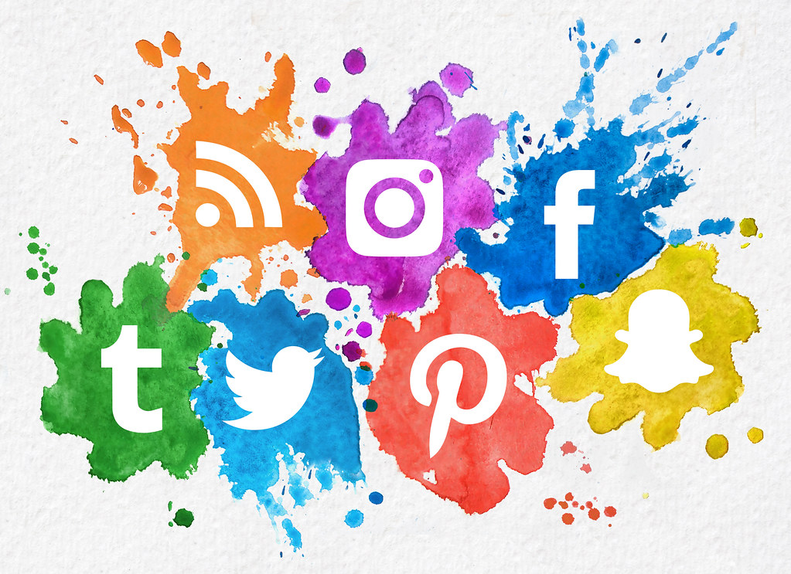
How are media and art related?
Certain artworks use AI to make their artwork with different art styles. According to what is the substantial relationship between Art and Media, the article mentions that in other words, the greatest difference between art and multimedia is found in the medium involved, that is, the used instrument. In what is the substantial relationship between Art and Media, the article states that the history of media and art history try to know how the media has been incorporated into the artistic process, and also how is that the same media can be transformed into artistic media.
Creator: Lewis Ogden

Slide 16
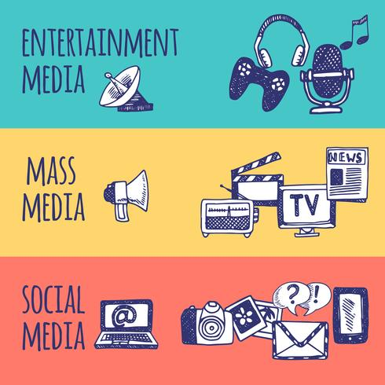
What can we see on media that changes our viewpoints of certain things?
Media can present misinformation to the public because some news stations do not state all the facts, and individuals use AI, everything seems to be real. According to social media is changing how we view real life, the article stated, but a human life is an experience for the beholder. In social media is changing how we view real life; a human life is being in the moment; the things we do and the things that happen to us. According to social media is changing he we view real life, the article mentioned that having this abstract “profile” that “encompasses” who a person is and what their life is like has inevitably changed the way we think about people, whether we realize it or not. According to social media is changing how we view real life, the article says when we see a person’s social media account online, we form interpretations of who they are and what they are like.
Creator: Macrovector Studios

Slide 17
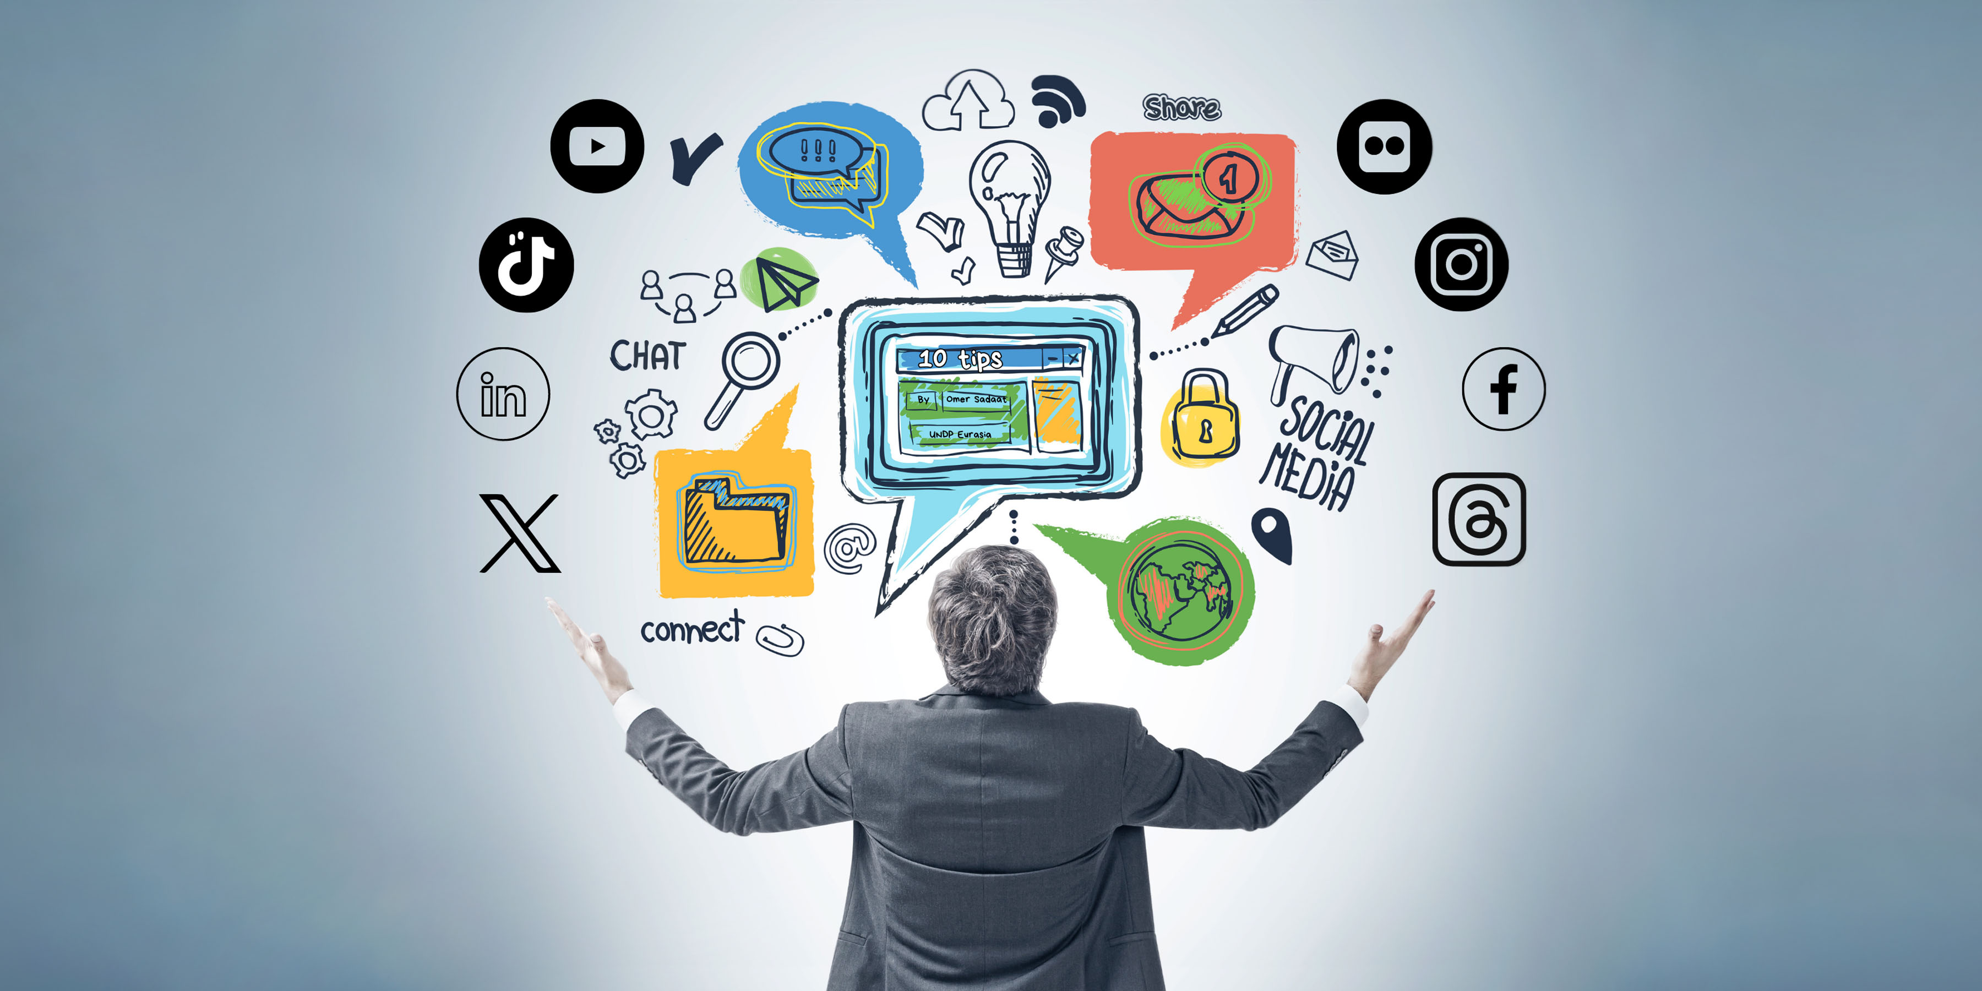
Why is media important in art?
Media is important in art because certain artworks are posted on social media and art galleries for individuals to view certain artworks. According to The Power of Press: Why Artists Need Media Coverage, the article says that exposure to a wider audience: In The Power of Press: Why Artists Need Media Coverage , the narrator mentioned that getting your work in front of a new audience is essential for gaining new fans and followers. According to The Power of Press: Why Artists Need Media Coverage , the article says, by getting media coverage, you can reach people who may have never heard of you before. In The Power of Press: Why Artists Need Media Coverage, the article states that this exposure can lead to more sales, In The Power of Press: Why Artists Need Media Coverage, the article states that, more show opportunities , According to The Power of Press: Why Artists Need Media Coverage, the article stated to, and more recognition in the art world.
Creator: Omer

Slide 18
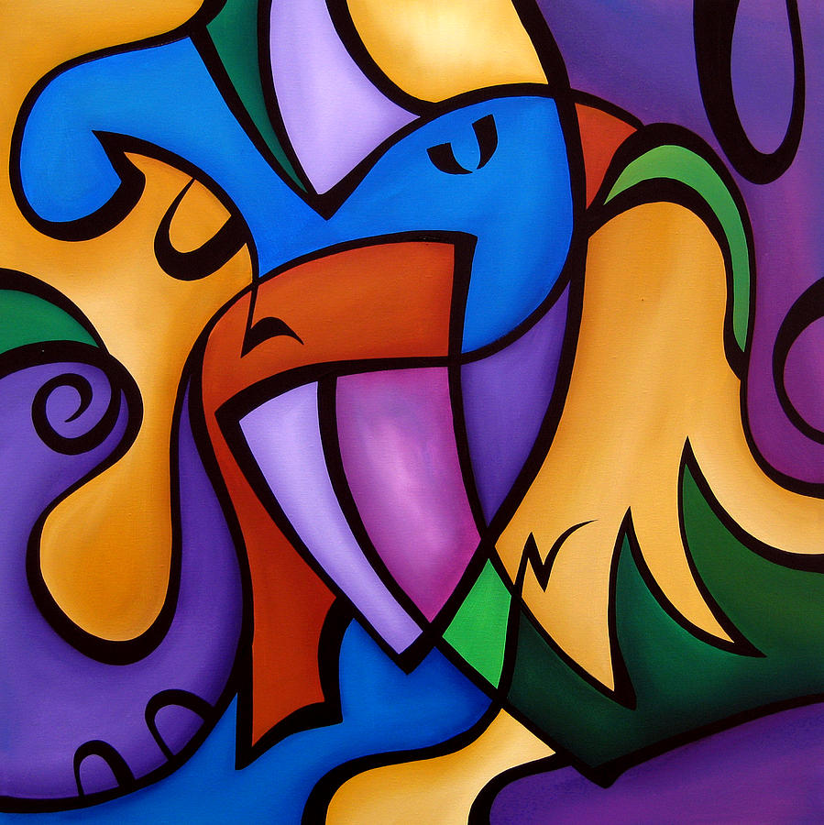
Why is abstract art important in media?
Abstract art is important in media because the artists can put a certain twist on their artworks, so that individuals can be interested by the concept of art to make their own artwork from their own experiences. According to Why Abstract Art Work, the article states that Abstract art's purpose is to encourage involvement and imagination, not to tell a story—at least not directly. I like to imply ideas with the paintings. In Why Abstract Art Works ,the article stated that others say that abstract art is "art for art's sake" and creates an object that stands on its own. According to Why Abstract Artwork, the article mentions that that’s a valid argument in my mind as well.
Creator: Tom Fedro

Slide 19
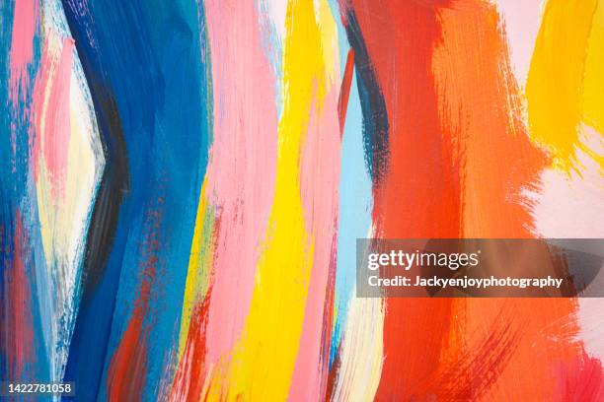
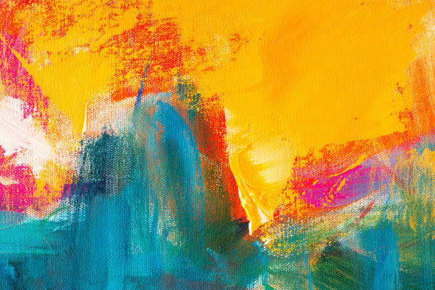
Why is there media in certain artworks?
Certain artworks incorporate some forms of media with the artists own experiences in their artworks. According to fine arts in the context of media culture, the article states that, unlike traditional galleries, mass media exposes fine art to larger specific audiences, thus promoting individual styles. In the fine arts in the context of media culture, the article says, according to Gever, mass media helps diversify the art industry compared to the traditional dogmatic approach, where gallery owners determined what was suitable for the audience.
Creator: Jackyenjoyphotograph, and ivanastar

Slide 20
Works Cited Page:
https://tiltwest.medium.com/art-in-the-age-of-social-media-1627aa44edc2
https://eclecticgallery.co.uk/news/244-art-and-social-media-the-impact-of-digital-art-in-the-digital-age-navigating-the-impact/
https://www.artworkarchive.com/blog/a-deep-look-at-digital-art-and-social-media
https://www.pewresearch.org/global/2022/12/06/views-of-social-media-and-its-impacts-on-society-in-advanced-economies-2022/
https://evolveartist.com/blog/do-artists-need-to-be-on-social-media/
https://pipelineartists.com/why-representation-matters-in-arts/
https://magazine.artland.com/how-social-media-is-shaping-art-the-impact-of-an-instagram-obsessed-culture/
https://jennarainey.com/is-social-media-making-your-art-bad/#:~:text=In%20today's%20digitally%20driven%20world,exposure%2C%20and%20even%20build%20careers.
https://artbusinessnews.com/2021/06/fine-arts-in-the-context-of-media-culture/
https://media-arts.gatech.edu/
https://www.thechicagoschool.edu/insight/from-the-magazine/a-virtual-life/
https://weareunlimited.org.uk/wp-content/uploads/2022/04/The-Impact-Of-Using-Social-Media-As-An-Artist-compressed.pdf
https://digartdigmedia.wordpress.com/2019/12/03/what-is-the-substantial-relationship-between-art-and-media/
https://meteamedia.org/17344/opinions/social-media-has-changed-the-way-we-think/
https://studioq.com/blog/2024/1/15/why-abstract-work
https://www.app.brush.bio/resources/artists-and-media-coverage
https://jerwoodvisualarts.org/digital-art-and-technology-glossary/hypermedia/#:~:text=Digital%20artists%20often%20use%20hypermedia,traditional%20art%20forms%20and%20technology.
https://www.istockphoto.com/photos/social-media-strategy
https://www.istockphoto.com/photos/social-media-marketing
https://www.istockphoto.com/photos/art
https://www.vecteezy.com/vector-art/3600932-set-of-square-social-media-icon-in-color-background
https://www.deviantart.com/dougsq/art/Video-Game-Characters-67984886
https://openoregon.pressbooks.pub/understandingnewmediaarts/chapter/introduction-to-new-media-arts/

